Slide 1
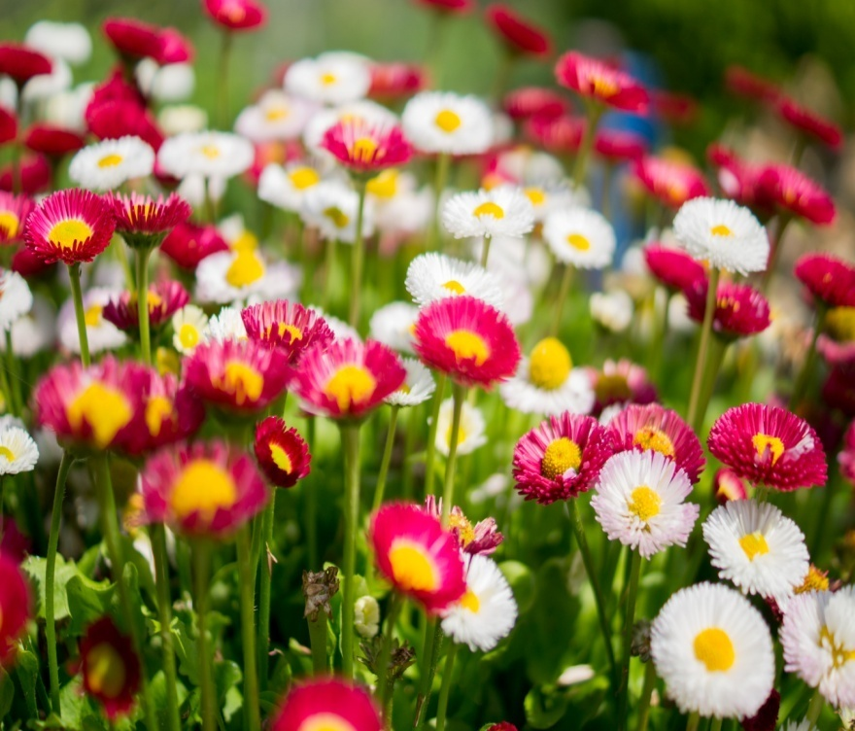
PRESENTATION OF ENGLISH II
PREPARED BY NISHCHAL BHATTA

Slide 2
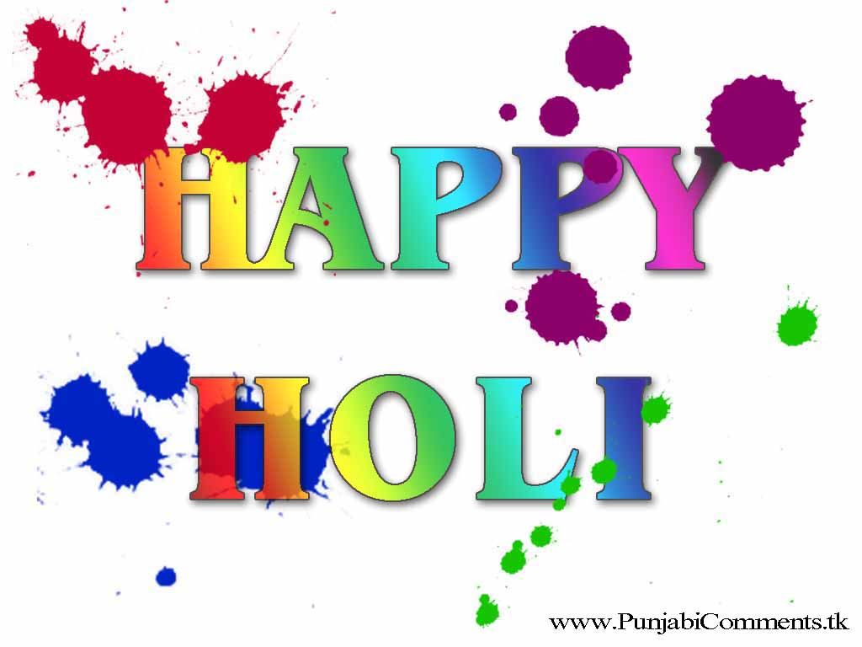
HAPPY HOLI
Holi also known as the "festival of colours", is a Hindu spring festival celebrated all across India and Nepal and among Hindus in Bangladesh and Pakistan as well in countries with large Indian subcontinent diaspora populations such as Suriname, Guyana, Trinidad and Tobago, South Africa, Malaysia, the United Kingdom, the United States, Canada, Mauritius, and Fiji. It signifies the victory of good over evil, the arrival of spring, end of winter, and for many a festive day to meet others, play and laugh, forget and forgive, and repair broken relationships. It is also celebrated as a thanksgiving for a good harvest.

Slide 3
It signifies the victory of good over evil, the arrival of spring, end of winter, and for many a festive day to meet others, play and laugh, forget and forgive, and repair broken relationships.It is also celebrated as a thanksgiving for a good harvest.It lasts for a night and a day, starting on the evening of the Purnima (Full Moon day) falling in the Vikram Samvat Hindu Calendar ^{[11]} month of Phalguna, which falls somewhere between the end of February and the middle of March in the Gregorian calendar. The first evening is known as Holik Dahan or Chhoti Holi and the following day as Holi, Rangwali Holi, Dhuleti, Dhulandi, or Phagwah.Holi is an ancient Hindu religious festival which has become popular with non-Hindus in many parts of South Asia, as well as people of other communities outside Asia . In recent years the festival has spread to parts of Europe and North America as a spring celebration of love, frolic, and colours.Holi celebrations start on the night before Holi with a Holika Dahan where people gather, perform religious rituals in front of the bonfire, and pray that their internal evil be destroyed the way Holika, the sister of the demon king Hiranyakashipu, was killed in the fire.

Slide 4
The next morning is celebrated as Rangwali Holi – a free-for-all festival of colours,[where people smear each other with colours and drench each other. Water guns and water-filled balloons are also used to play and colour each other. Anyone and everyone is fair game, friend or stranger, rich or poor, man or woman, children and elders. The frolic and fight with colours occurs in the open streets, open parks, outside temples and buildings. Groups carry drums and other musical instruments, go from place to place, sing and dance. People visit family, friends and foes to throw coloured powders on each other, laugh and gossip, then share Holi delicacies, food and drinks.Some customary drinks include bhang (made from cannabis), which is intoxicating.In the evening, after sobering up, people dress up and visit friends and family.

Slide 5
WHY HOLI FESTIVAL IS CELEBRATED?
According to Bhagavat Purana,a king named Hiranyakashipu who, like many demons and Asuras, had the intense desire to be immortal. To fulfill this desire, he performed the required Tapas or penances until he was granted a boon by Brahma. Since the Gods rarely granted immortality, he used his guile and cunning to get a boon that he thought made him immortal. The boon gave Hiranyakashyapu five special powers: he could be killed by neither a human being nor an animal, neither indoors nor outdoors, neither at day nor at night, neither by astra (projectile weapons) nor by any shastra (handheld weapons), and neither on land nor in water or air. As this wish was granted, Hiranyakashyapu felt invincible, which made him arrogant. Hiranyakashyapu decreed that only he be worshiped as a God, punished and killed anyone who did not accept his orders. His son Prahlad disagreed with his father, and refused to worship his father as a god. He continued believing and worshipping Lord Vishnu.
This made Hiranyakashipu very angry and he made various attempts to kill Prahlad. During a particular attempt on Prahlad's life, King Hiranyakashyapu called upon his sister Holika for help. Holika had a special cloak garment that prevented her from being harmed by fire. Hiranyakashyapu asked her to sit on a bonfire with Prahlad, by tricking the boy to sit on her lap.

Slide 6
However, as the fire roared, the garment flew from Holika and covered Prahlad. Holika burnt to death, Prahlad came out unharmed.
Vishnu appeared in the form of Narasimha - half human and half lion, at dusk when it was neither day nor night, took Hiranyakashyapu at a doorstep, placed him on his lap (which was neither land, water nor air), and then eviscerated and killed the king with his lion claws which were neither a handheld weapon nor a launched weapon. In this form, the boon of five special powers granted to Hiranyakashyapu were no longer useful. Prahlad and the kingdom of human beings were thus free from the compulsion and fear of Hiranyakashyapu, showing the victory of good over evil.

Slide 7
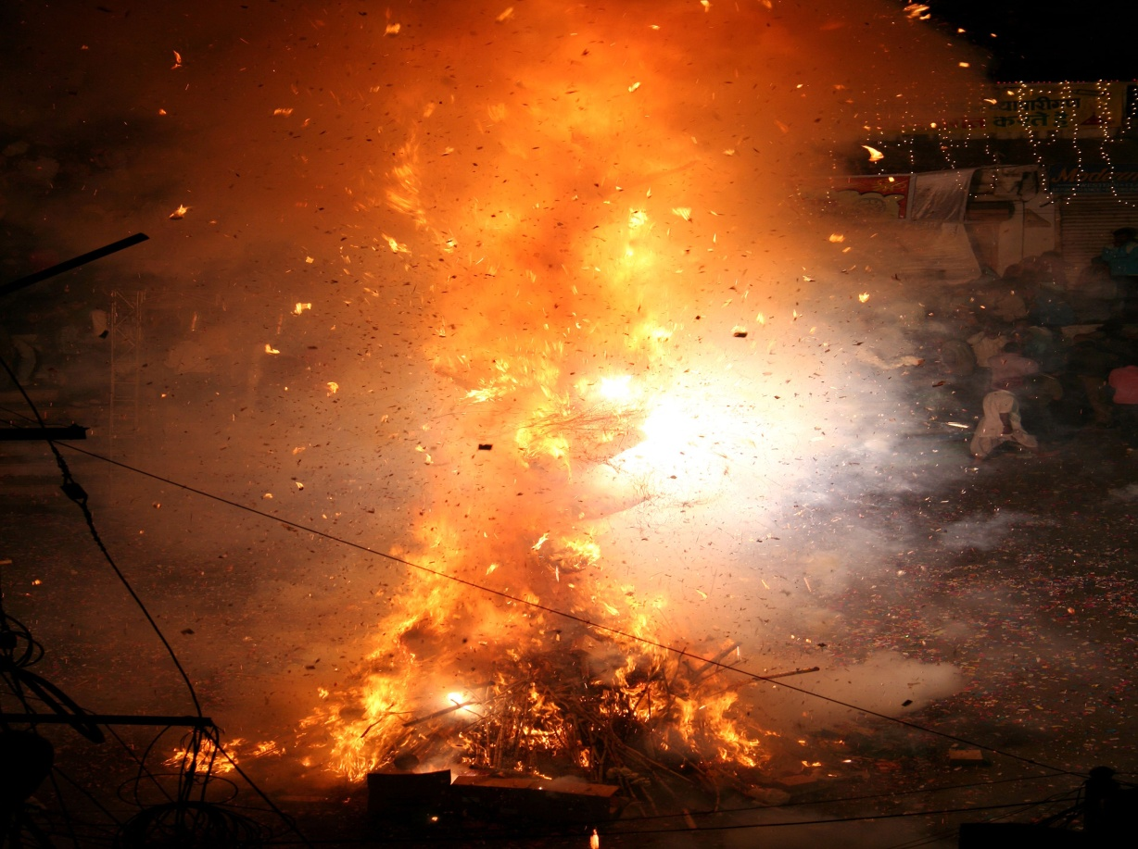
INTRODUCTION OF HOLIKA
Holika was a demoness in Hindu Vedic scriptures, who was burnt to death
with the help of God Vishnu. She was the sister of King Hiranyakashipu and
aunt of Prahlad.
The story of Holika Dahan (Holika's death) signifies the triumph of good over
evil. Holika is associated with the annual bonfire on the night before Holi, the
Hindu festival of colors.

Slide 8
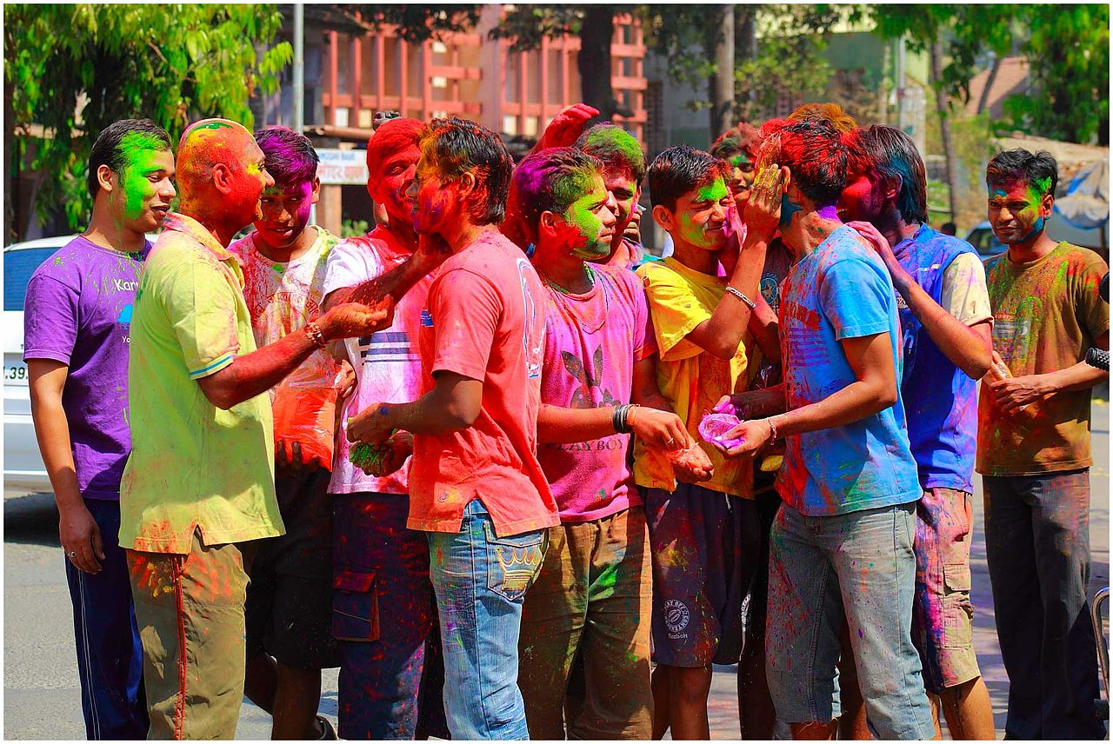
HOLI CELEBRATION
Holi is not a one day celebration but it is celebrated for three days.
1. In the first day on the full moon day or Holi Purnima colored powder and
water are arranged in small brass pots on a thali. The celebration begins with
the eldest male member of the family.
2. The second day is also known as ‘Puno’. On this day Holika ‘s images are
burnt and people even light bonfires to remember the story of Holika and
Prahalad . Mothers with their babies take five rounds of the bonfire in a
clockwise direction to seek the blessing of the God of fire.
3. The third is known as ‘Parva’ and this is the last and final day of Holi
celebrations. On this day colored powder and water is poured on each
other.The deities of Radha and Krishna are worshiped and smeared with
Colors.

